Slide 1
Web app with Django and React slideshow
by Vilim Branica

Slide 2
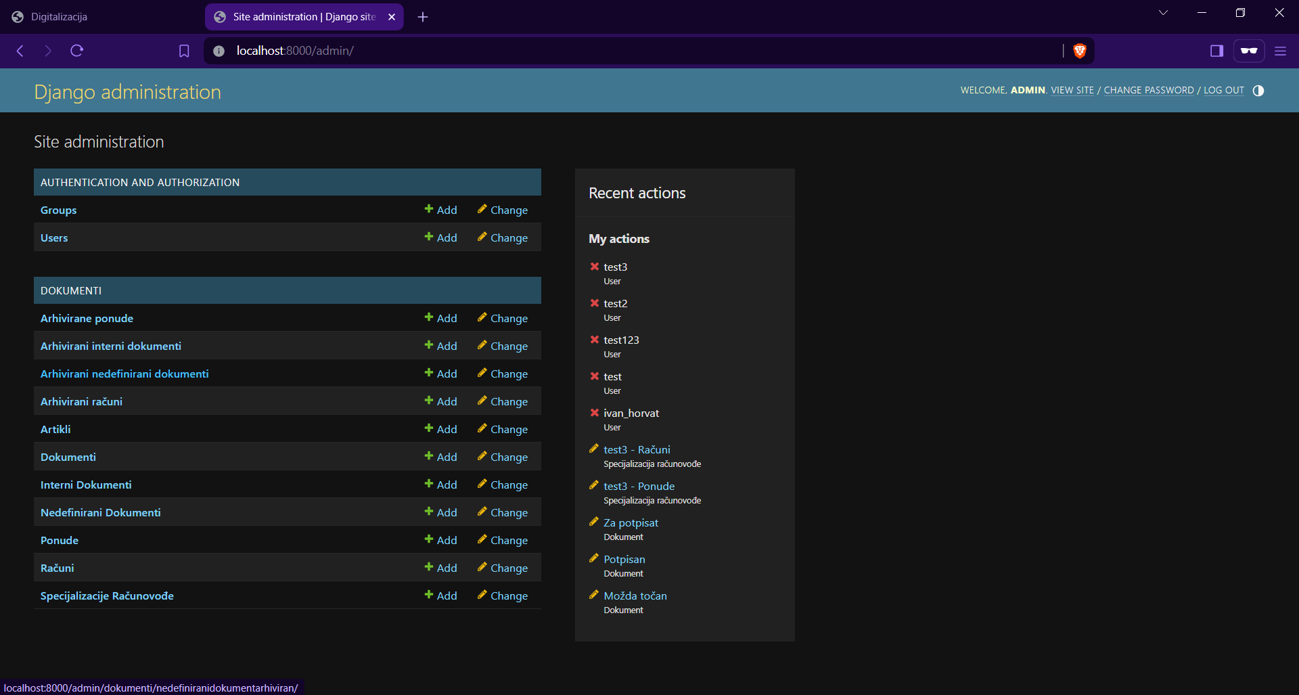
Model manipulation in django admin interface

Slide 3
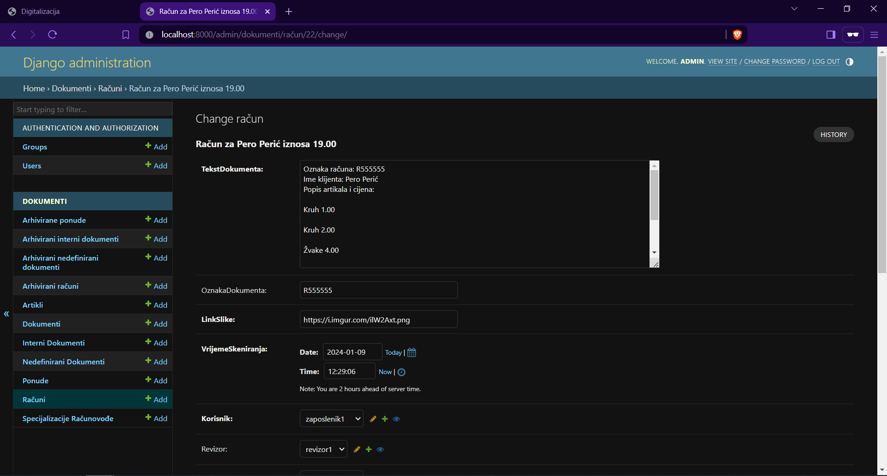
The „document” model consists of fields: text, documentId, link to the source image, date and time of scan, the employee who scanned it, the revisor who needs to review it and accountant who can send it to the director for signing or archieve it.

Slide 4
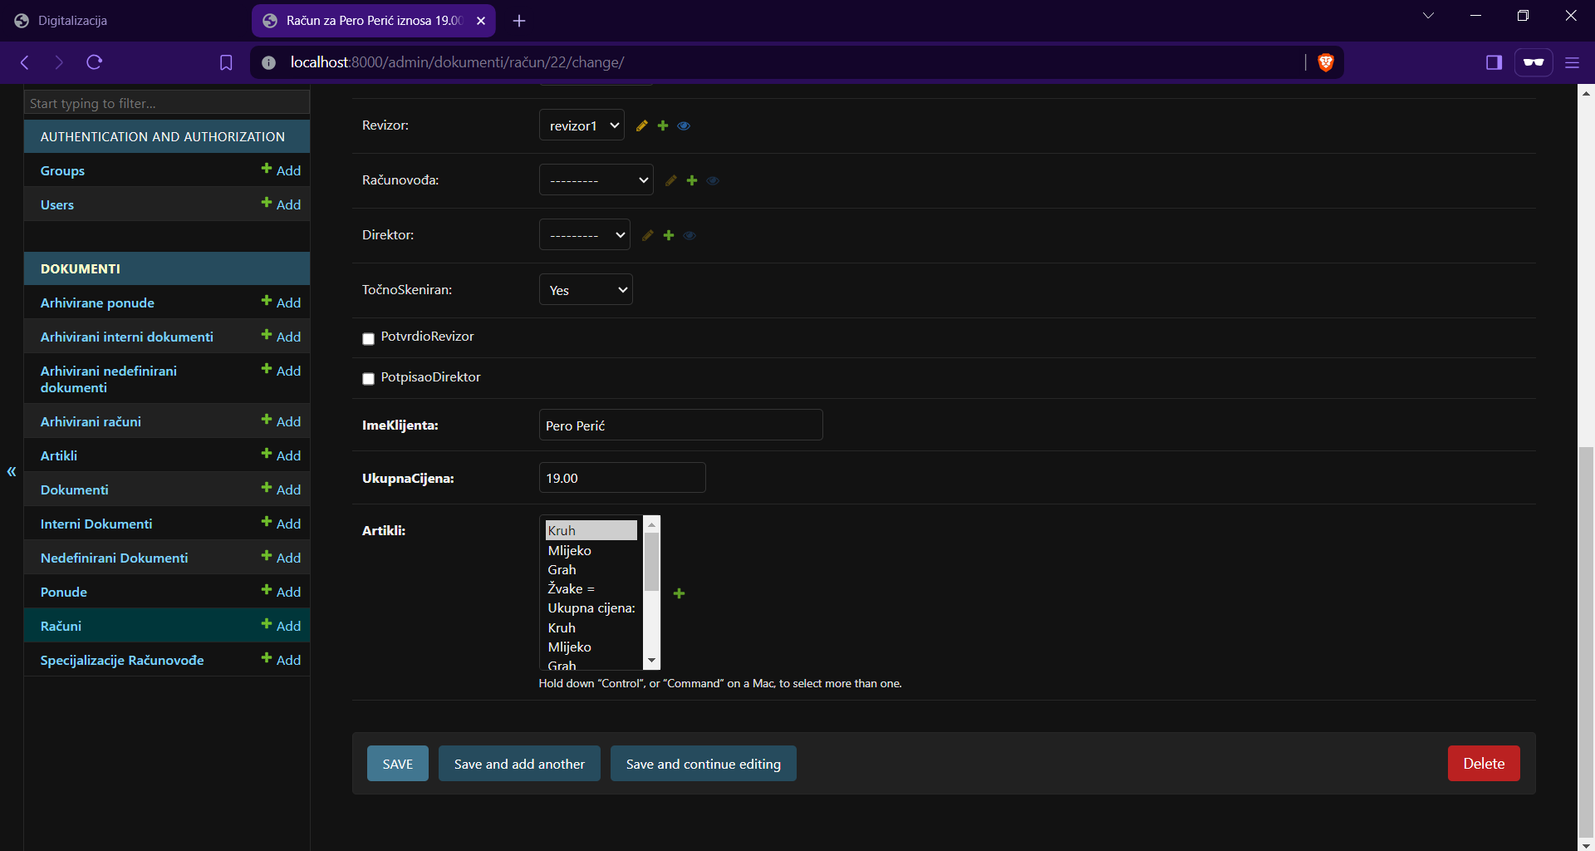
The „receipt” type of document has extra fields client_name, total_price and a list of articles it contains.

Slide 5
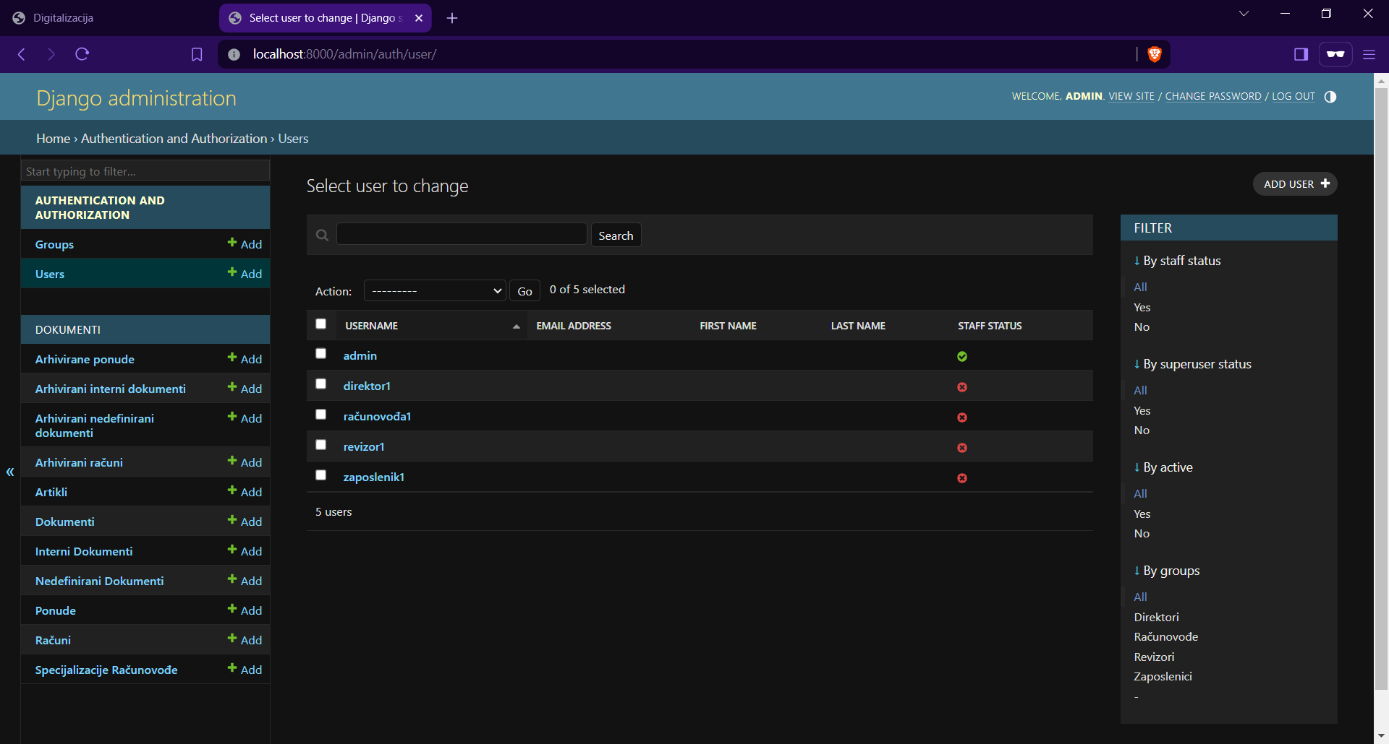
List of employees in the database

Slide 6
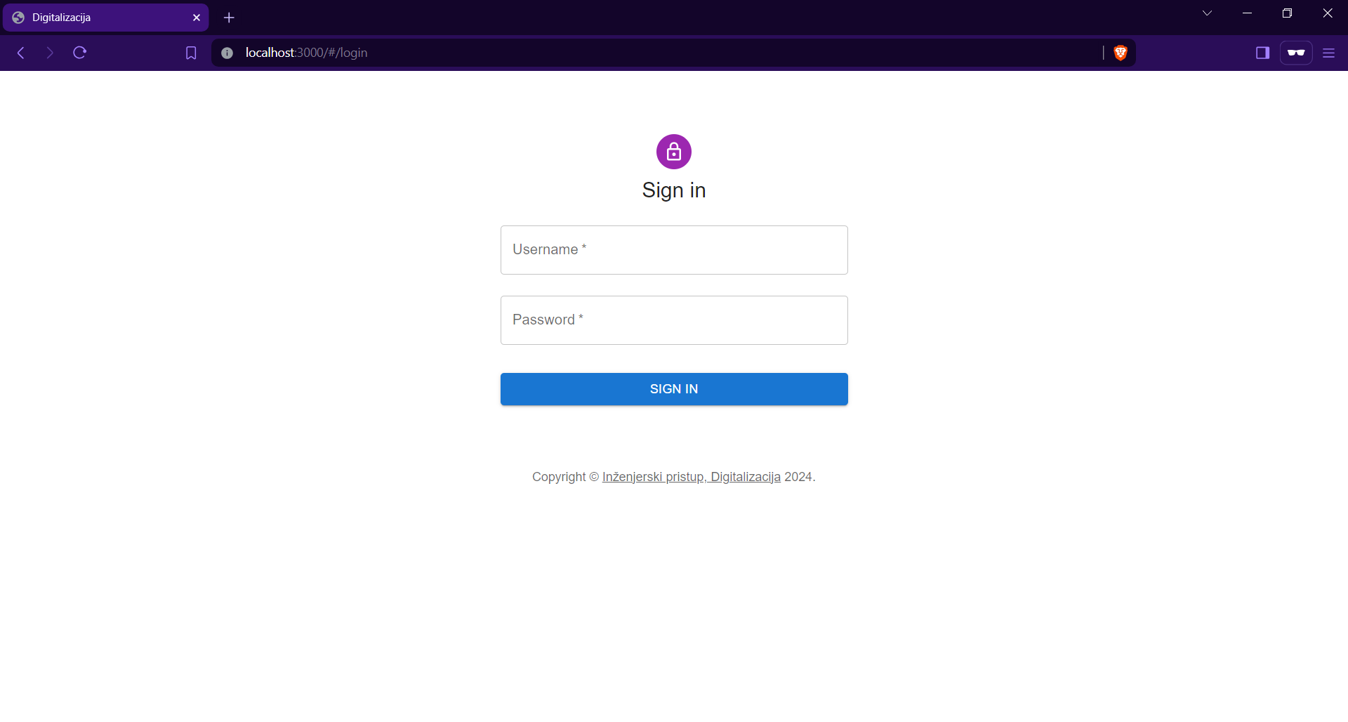

Slide 7
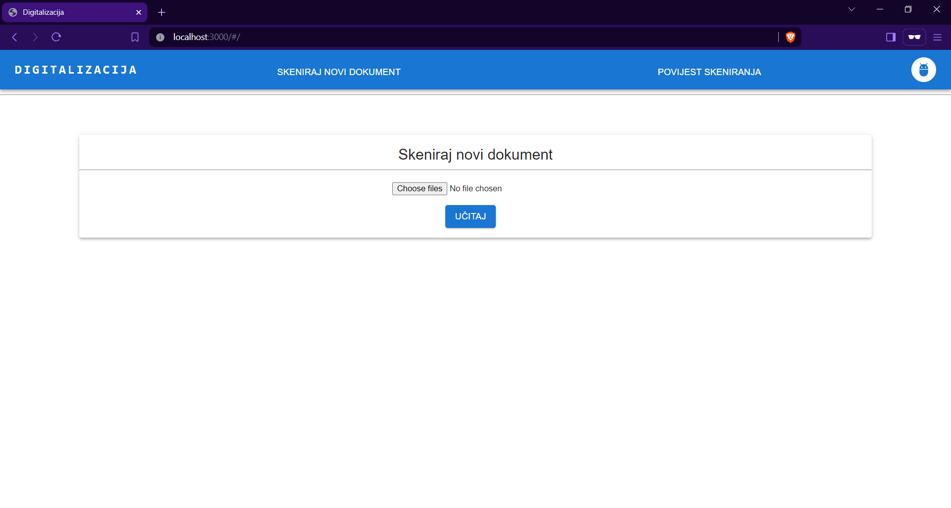
Here the employee can scan new documents as images, which are then processed by OCR software and the text document is generated.

Slide 8
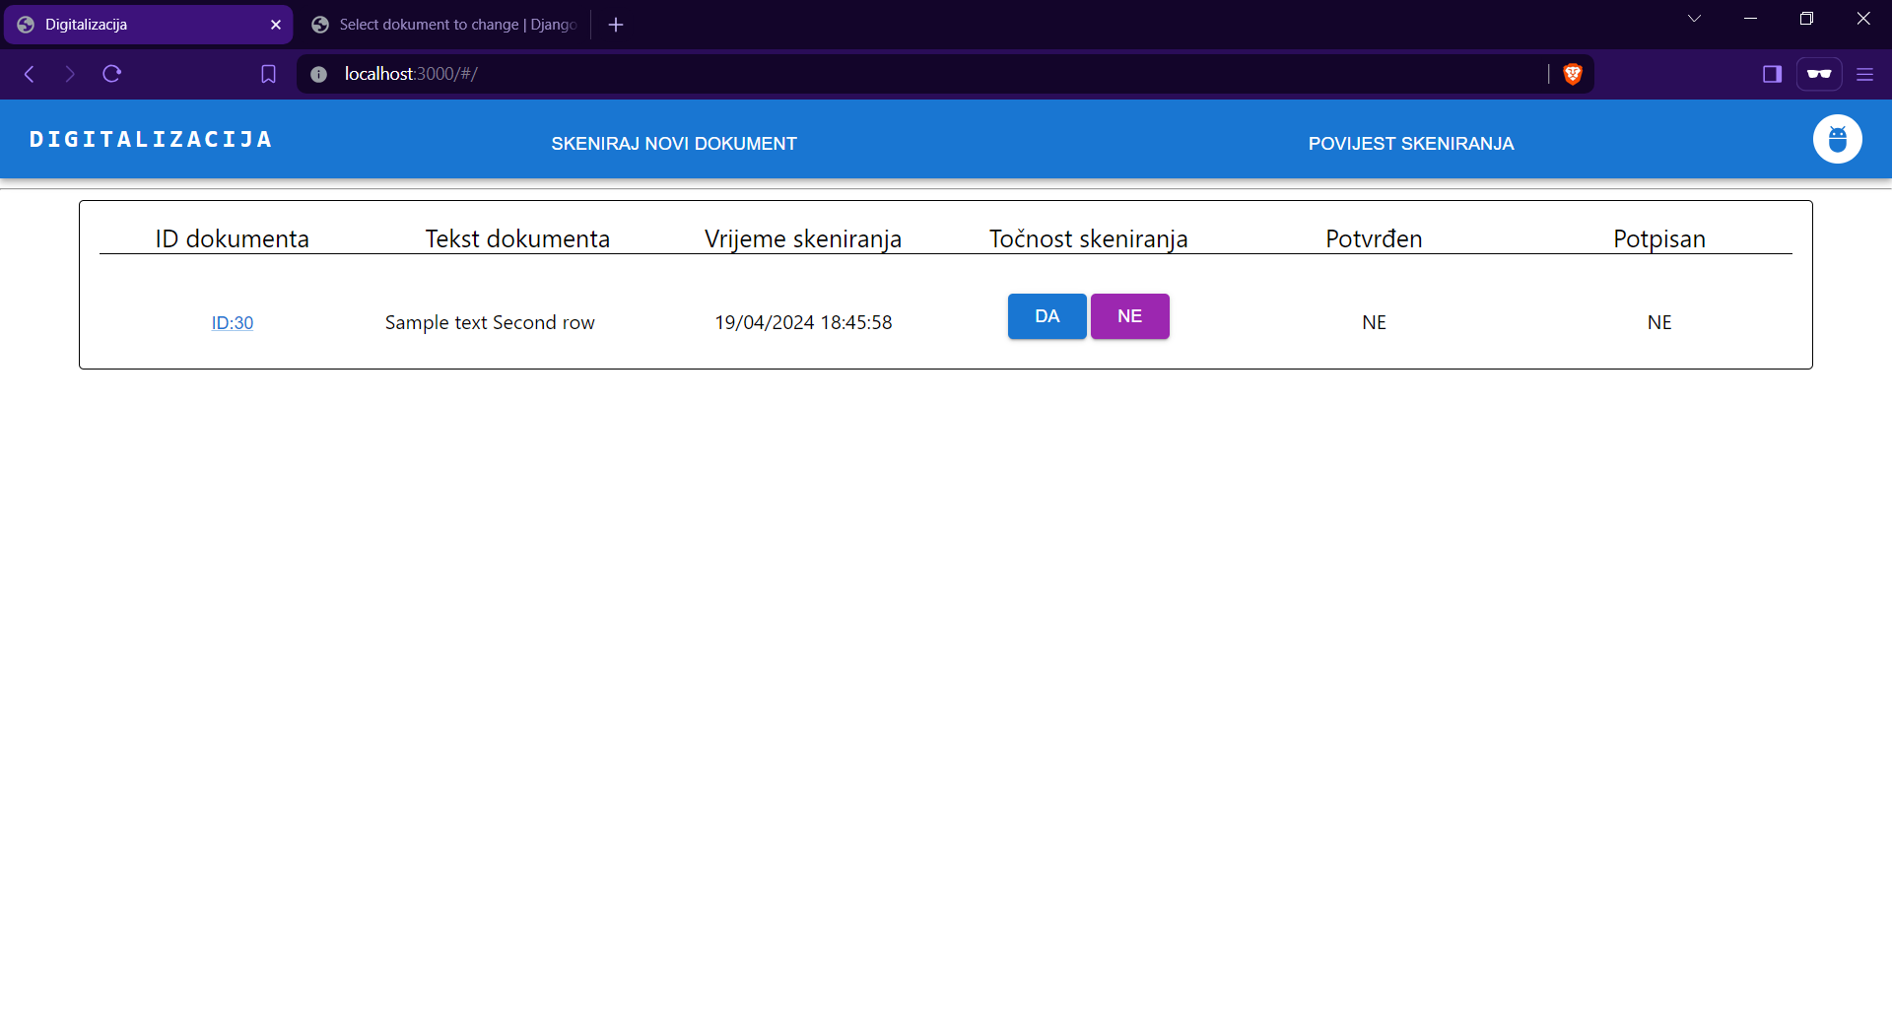
Each employee can confirm scanning validity and decide which revisor to send it for revision.

Slide 9
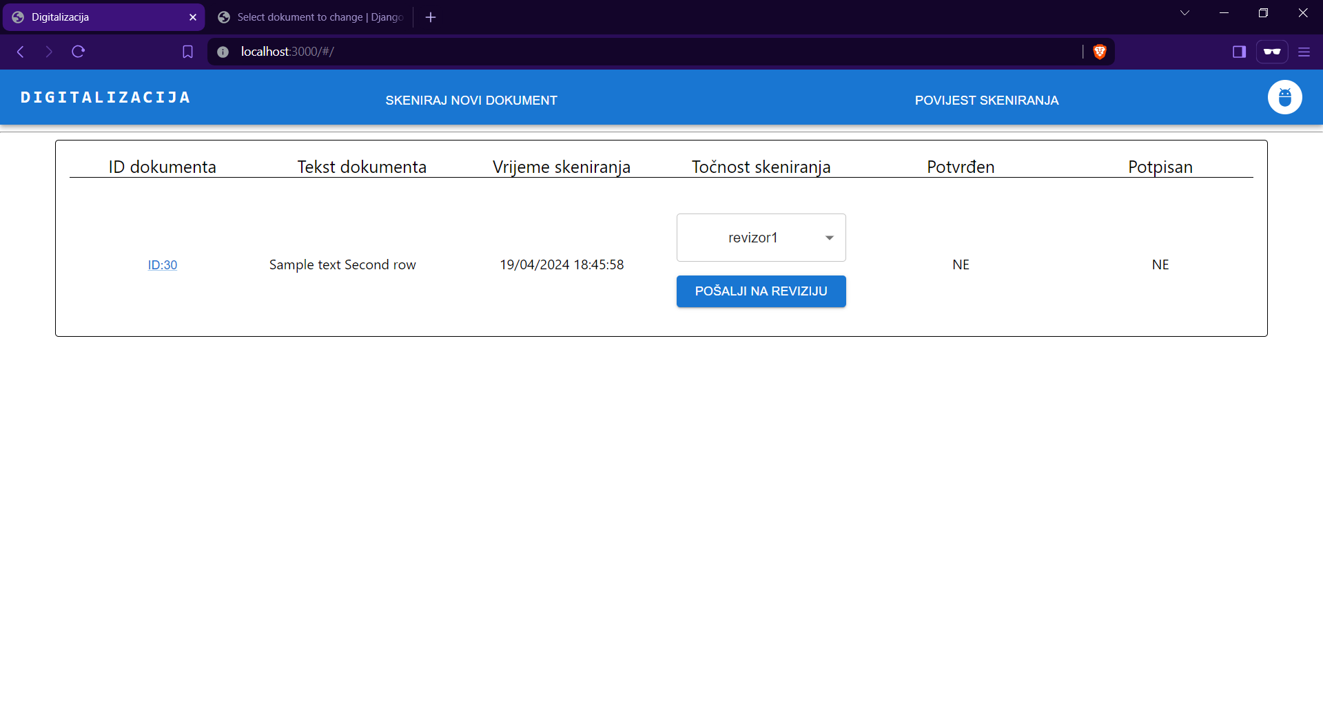

Slide 10
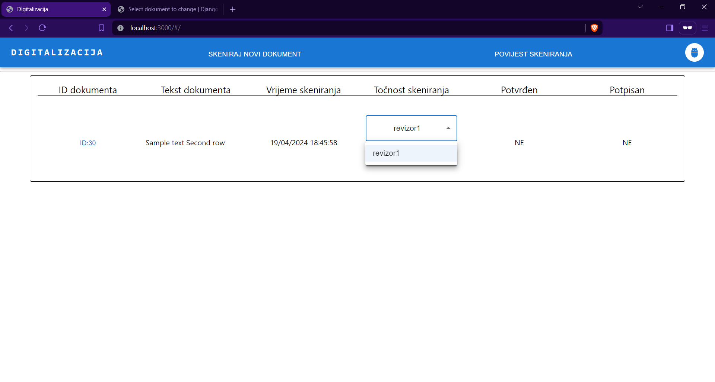

Slide 11
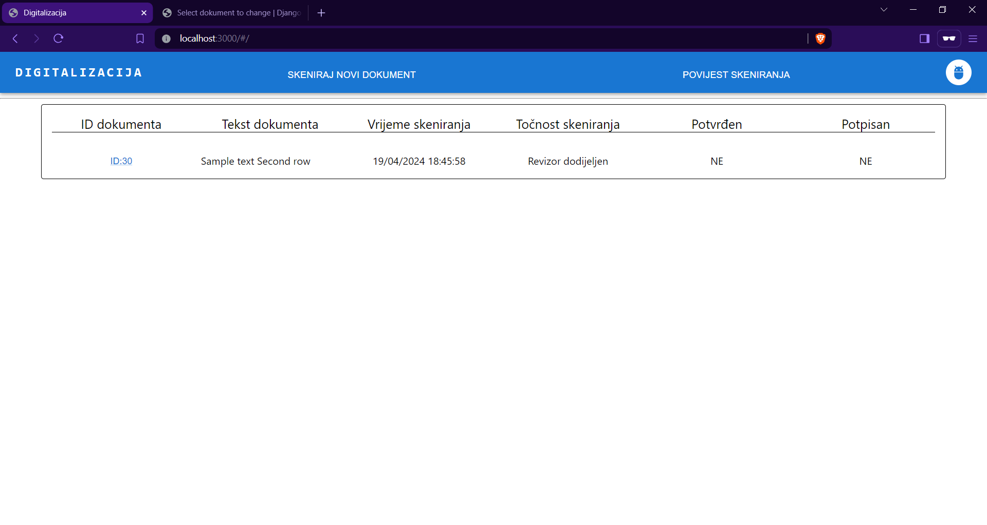
The document has not been confirmed nor signed yet
Here, the revisor has been assigned.

Slide 12
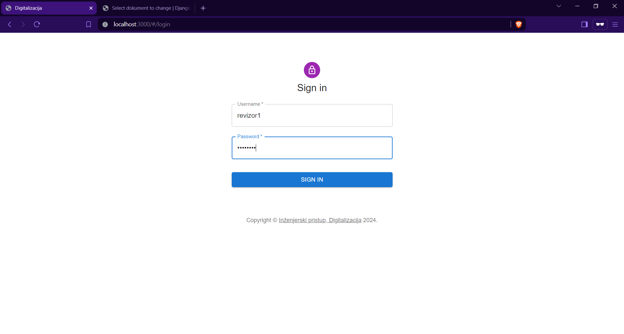
Now log in as the revisor.

Slide 13
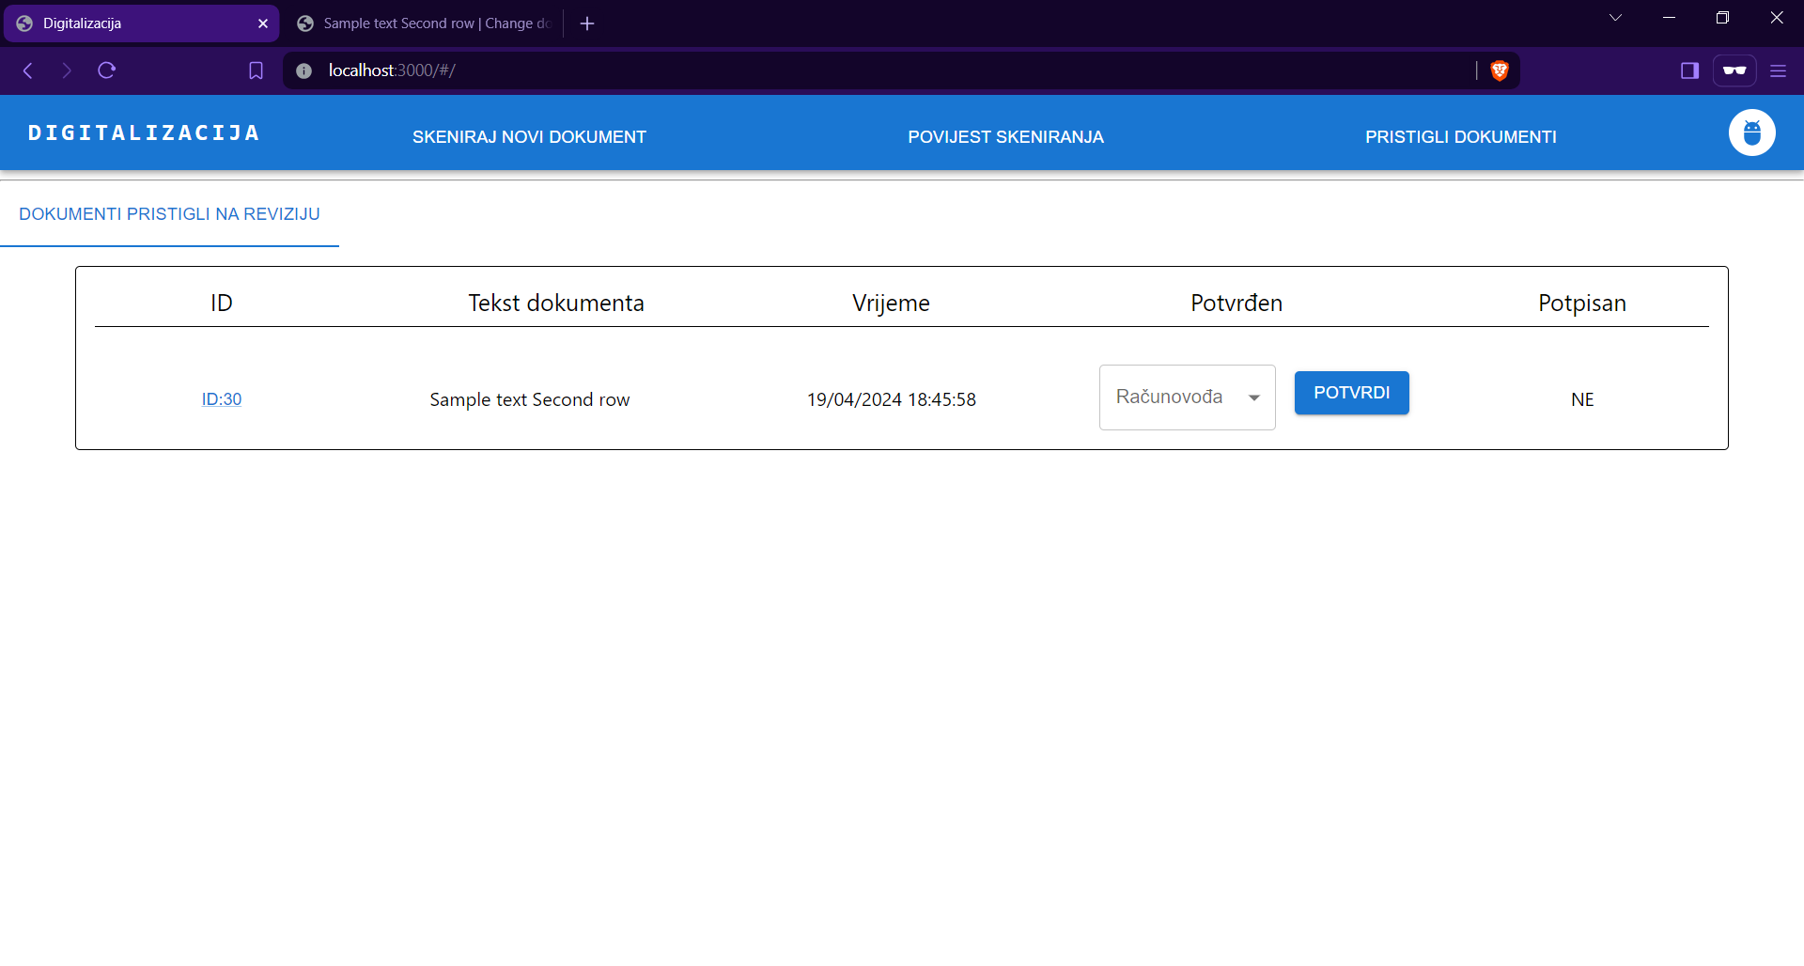
Revisors can confirm the document and send it to one of the accountants.

Slide 14
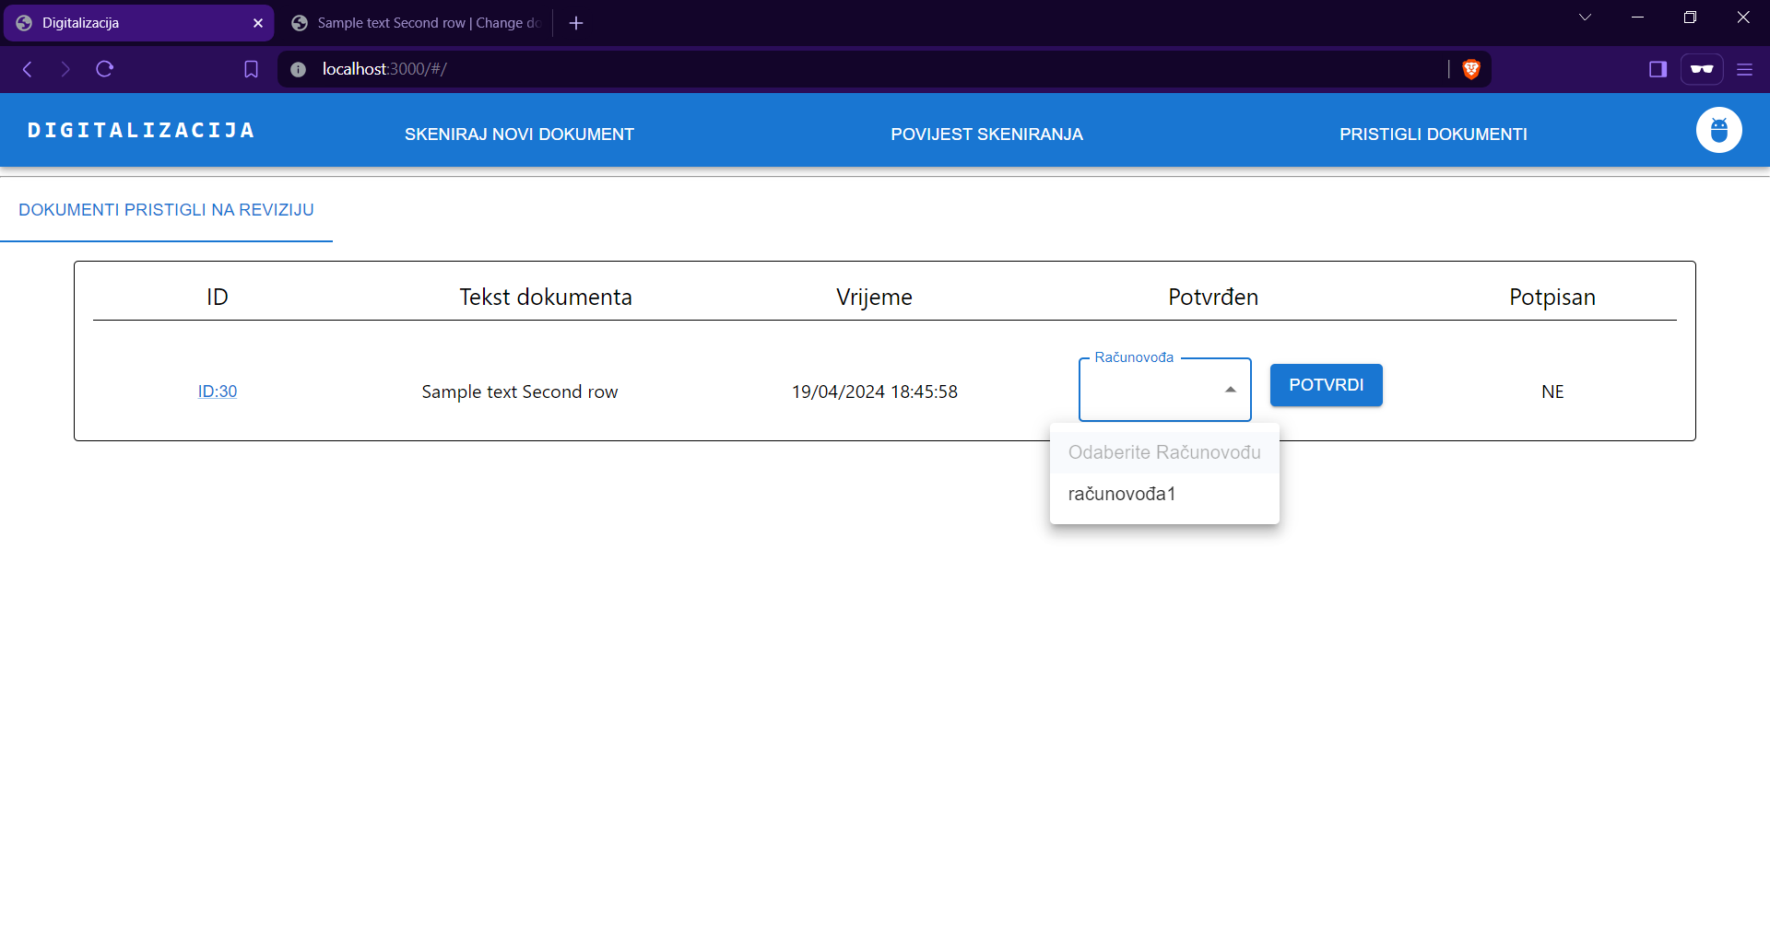

Slide 15
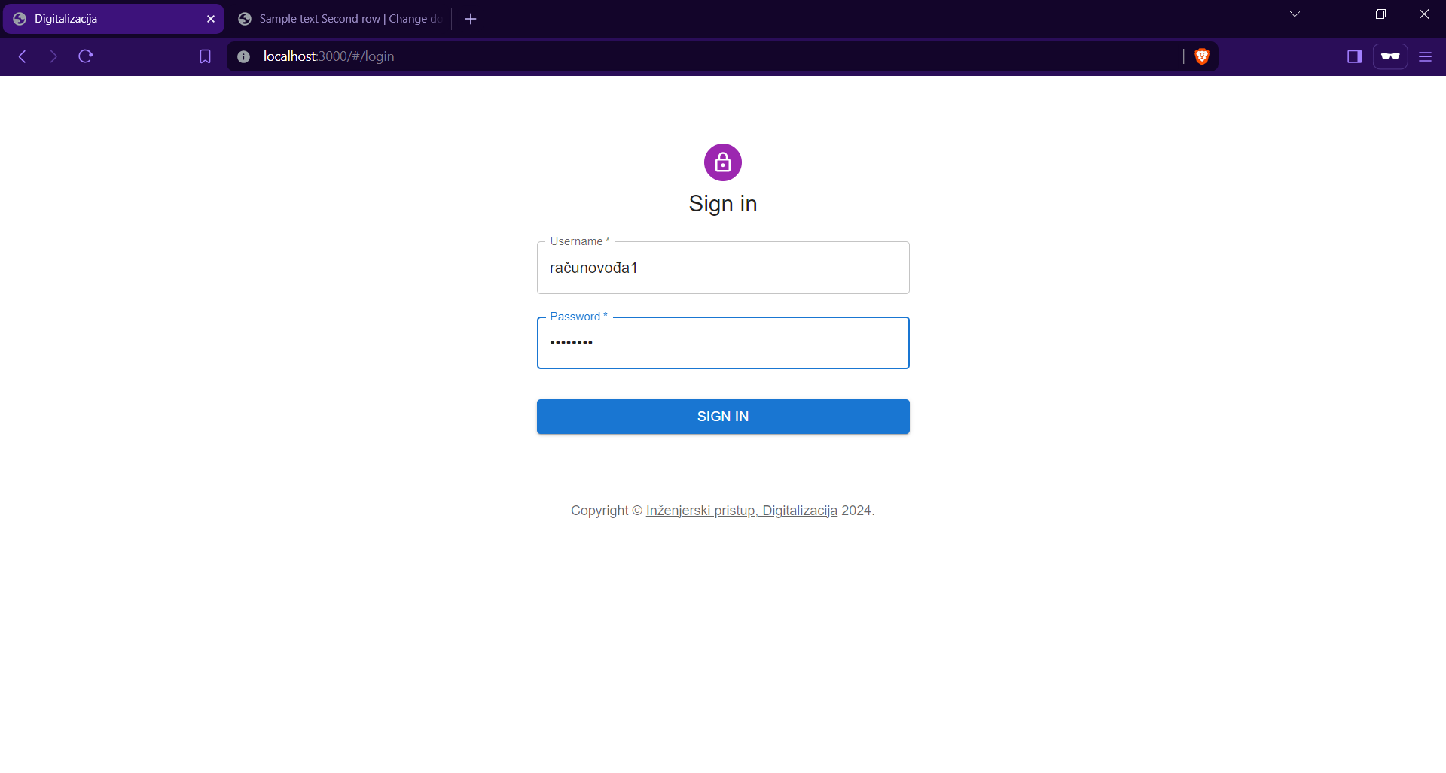
Log in as an accountant the document has been assigned to.

Slide 16
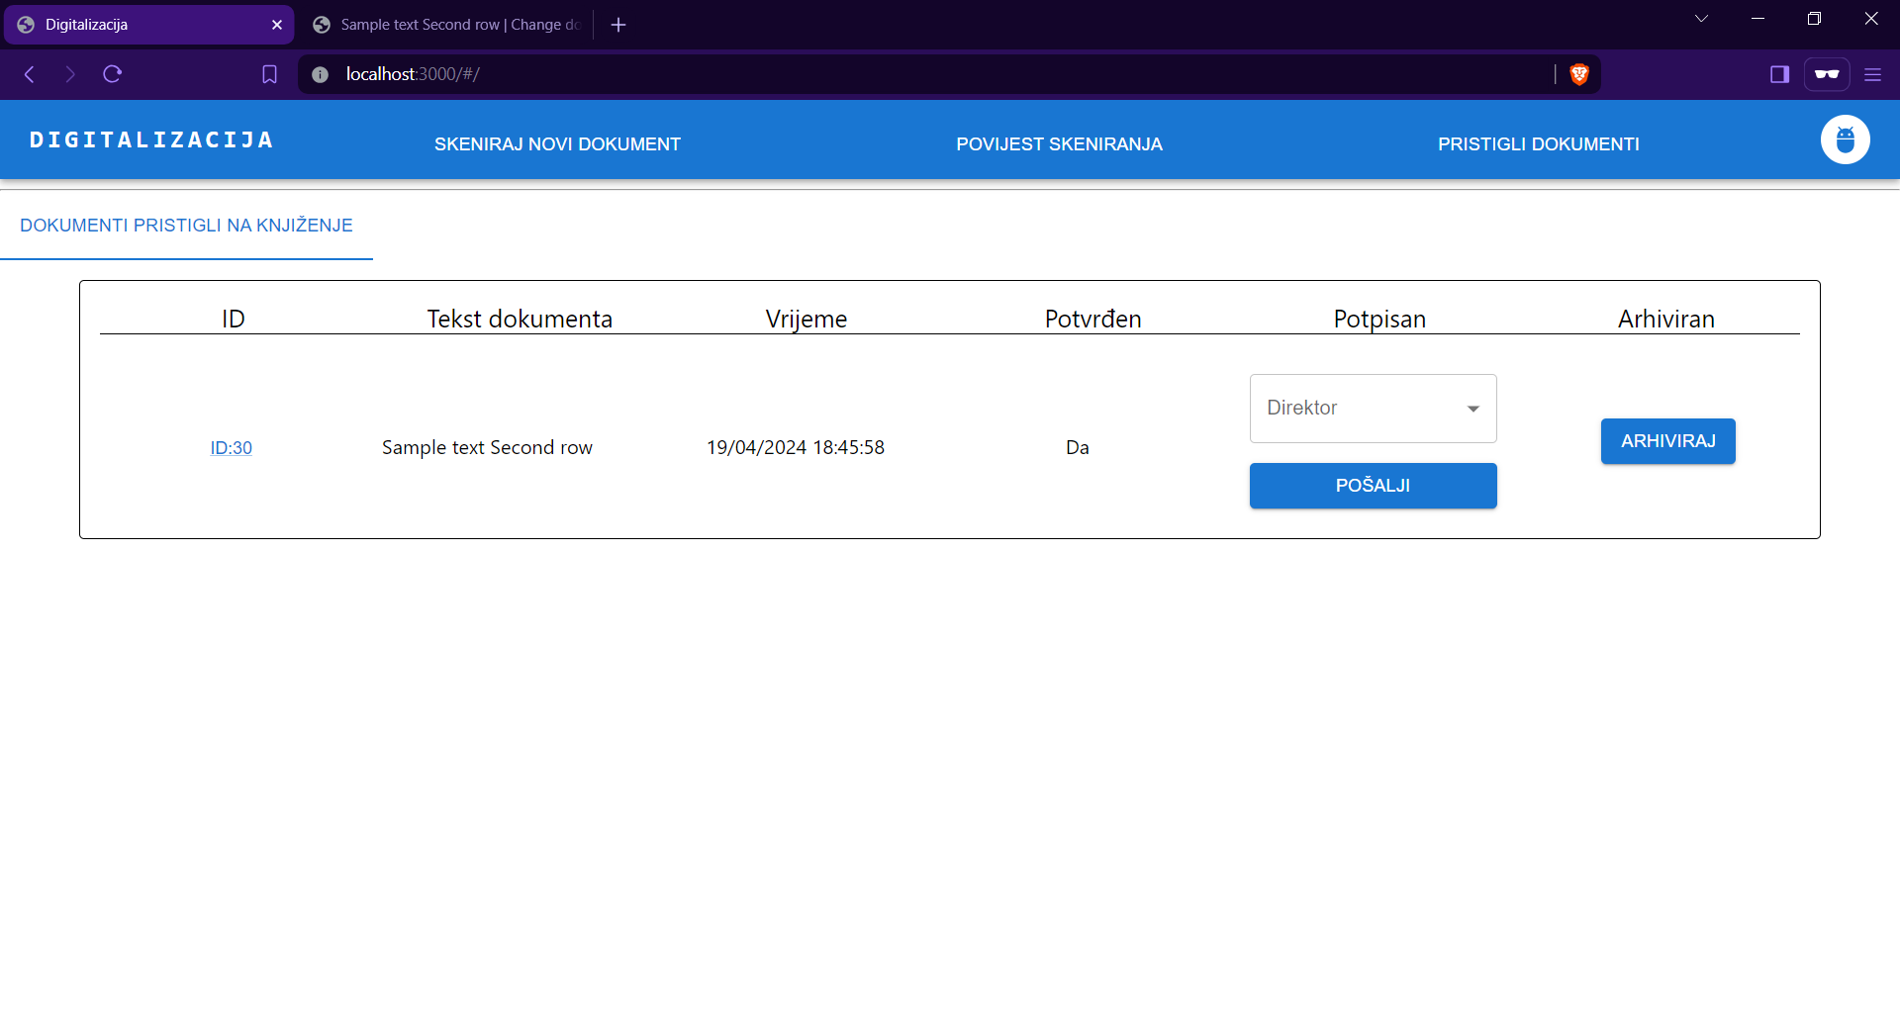
Accountants can either send the document to the director for signing or archive it.

Slide 17
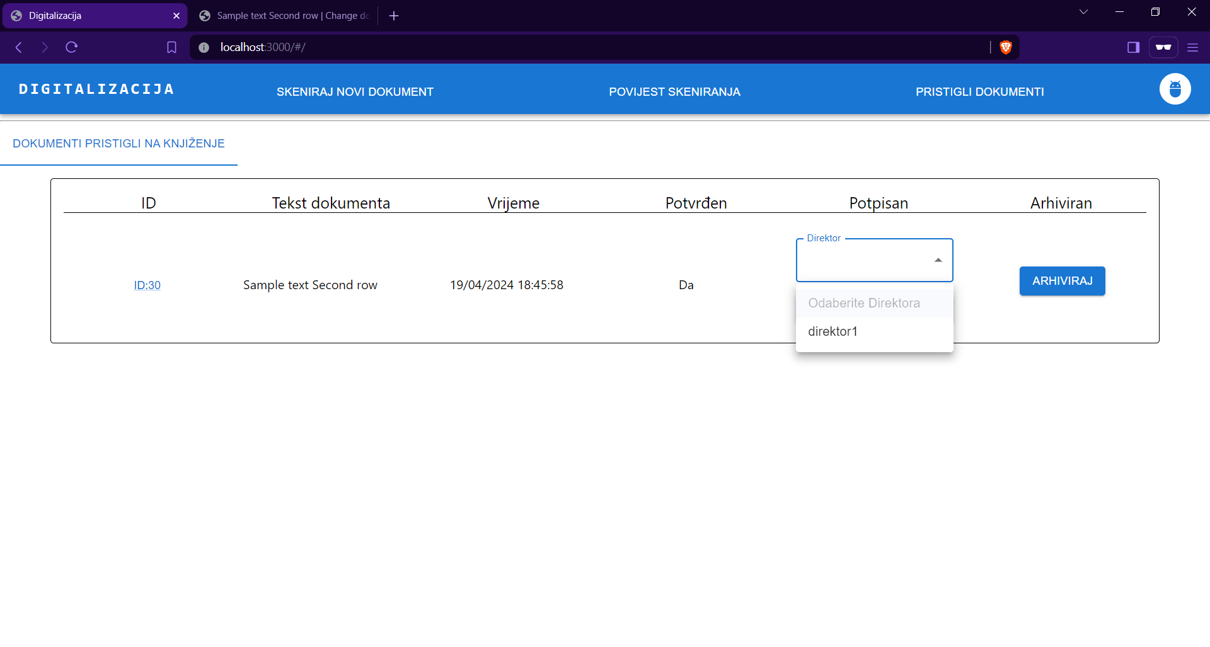

Slide 18
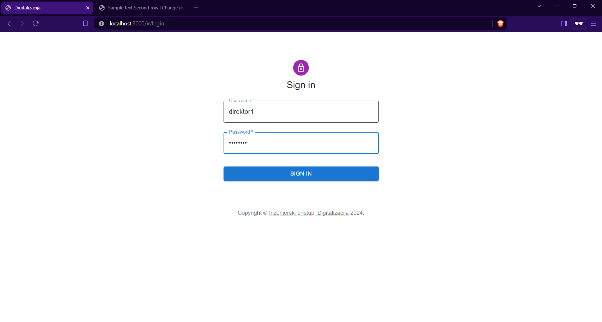
Log in as director.

Slide 19
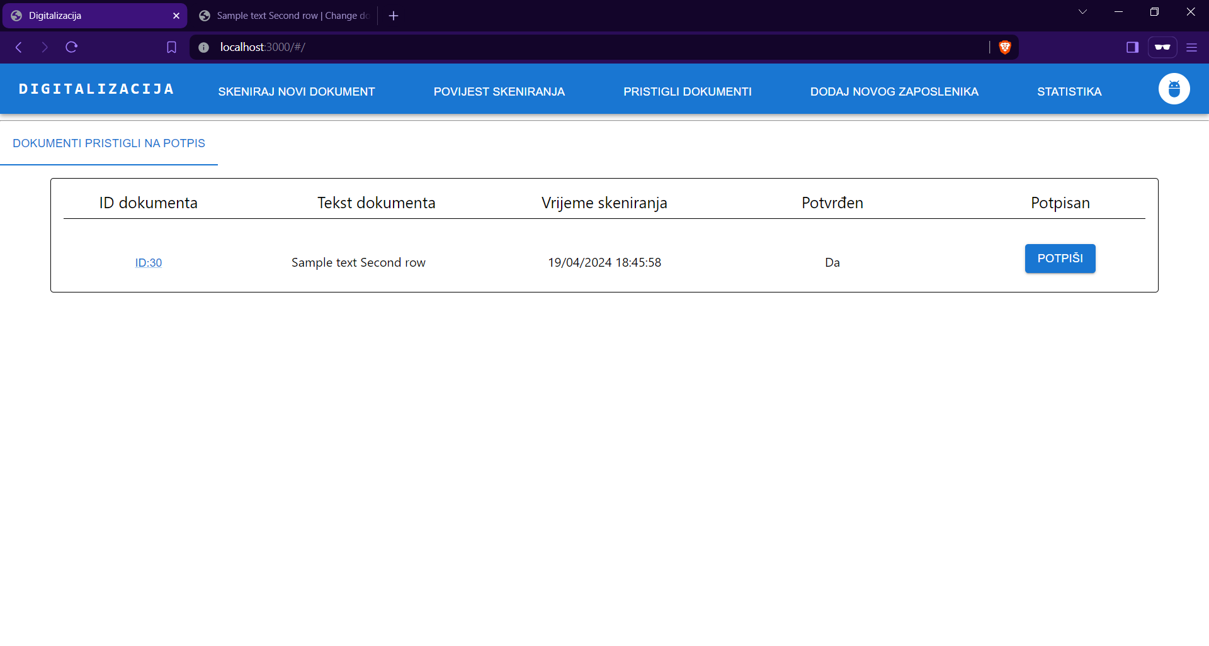
Directors can sign documents, add new employees or view the statistics about employees.

Slide 20
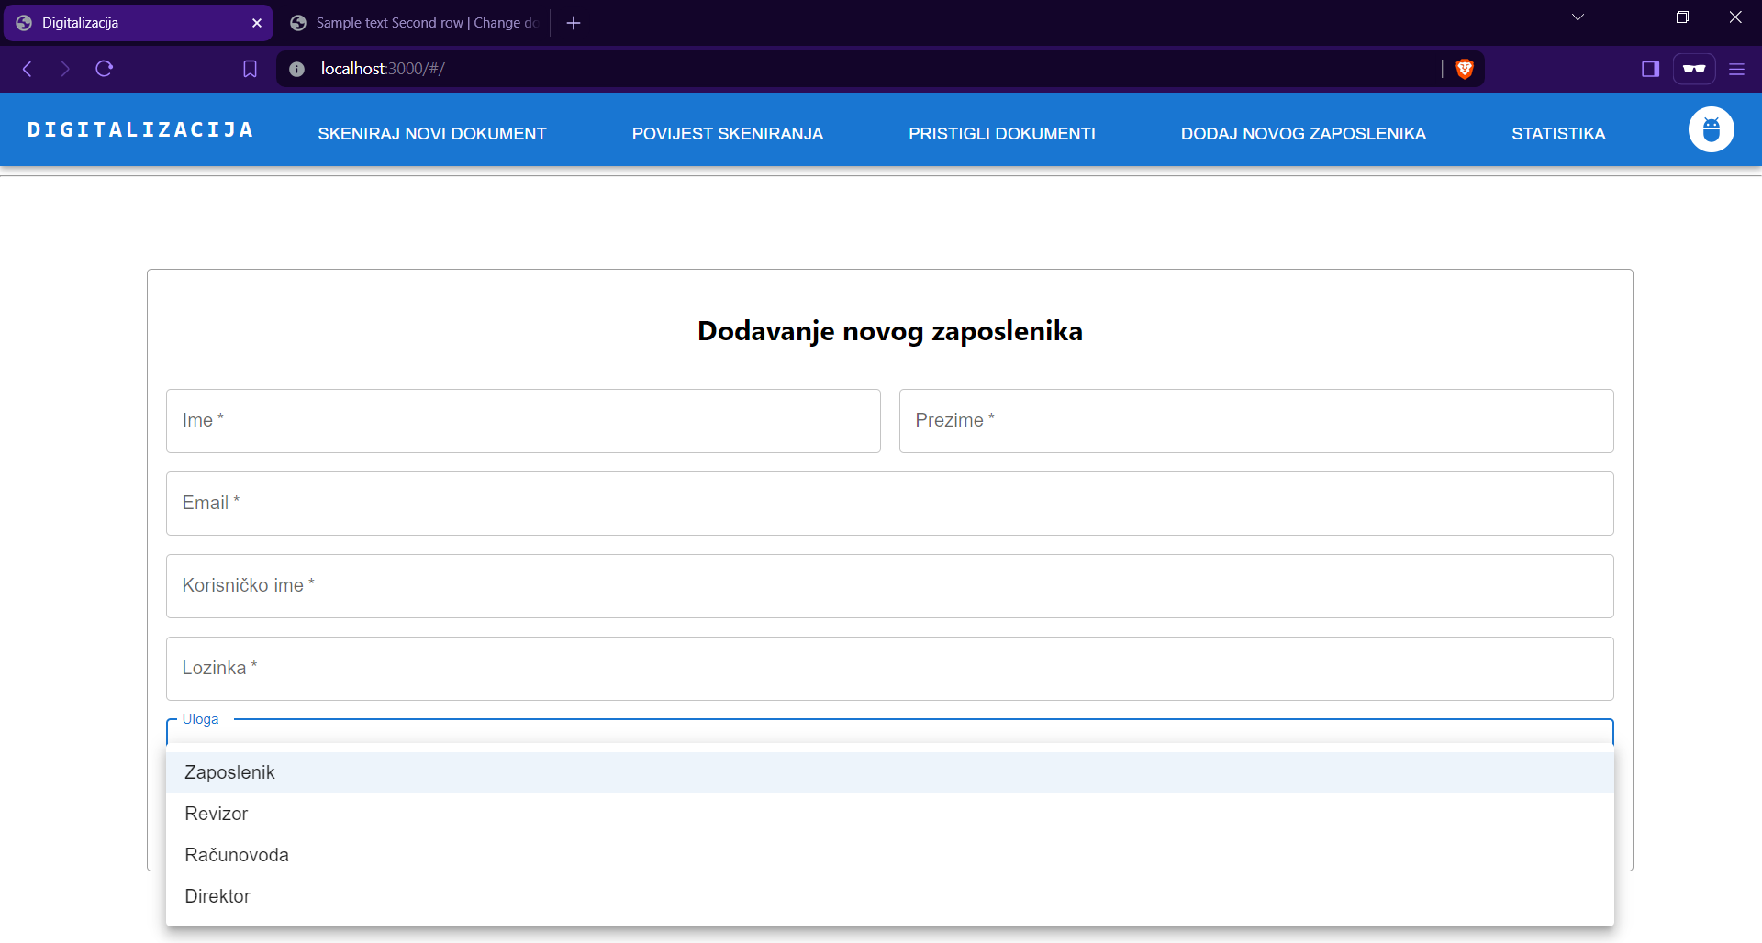
Adding new employees consists of defining name, surname, email, username, password and defining employee role (revisor, accontant, director …)

Slide 21
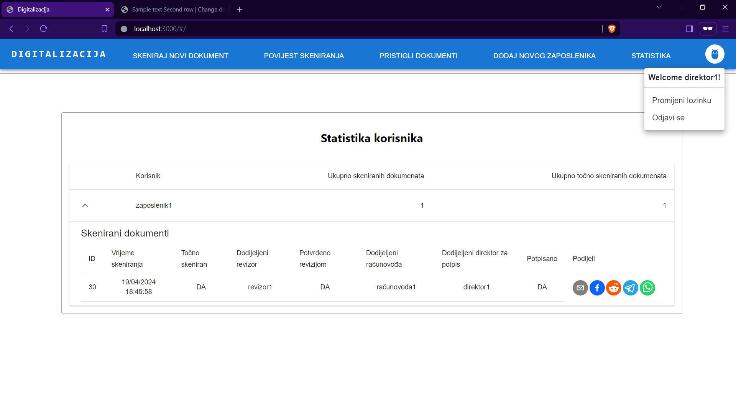
Any user can change password
A director can see information about all documents and statistics of all employees in the company. A director can also share the document information on various social media.

Slide 22
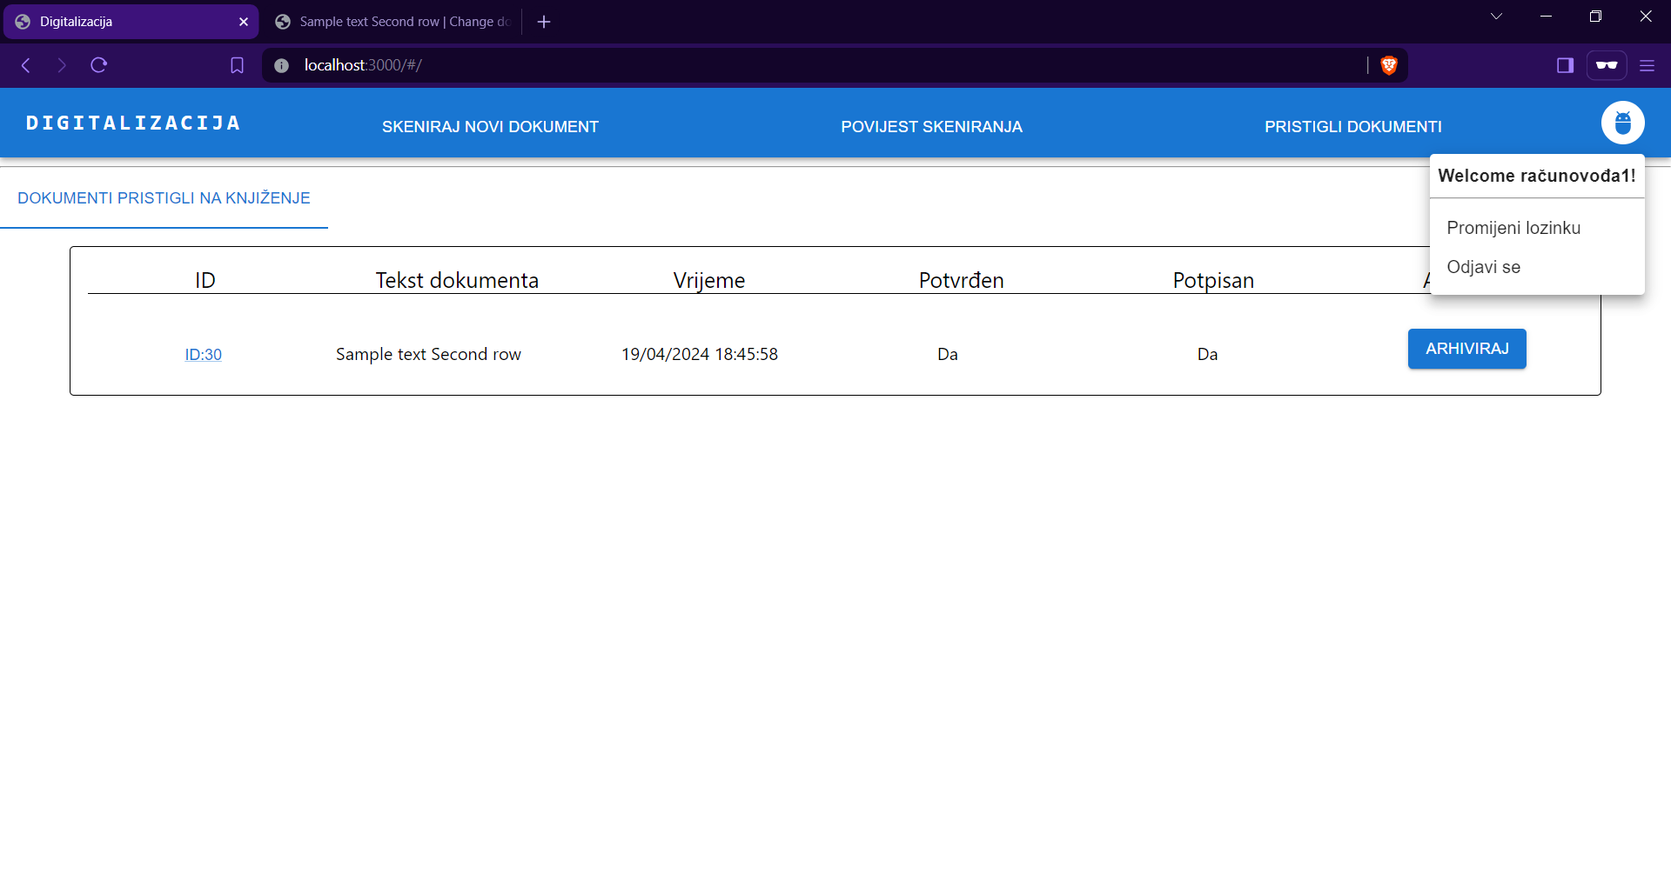
The document is signed and the accountant can archive it now.

